Slide 1
Real-time IO-oriented Soar Agent for Base Station-Mobile Control David Daniel, Scott Hastings L-3 Communications

Slide 2


Illustrative Concept
A means to optimize transmission power and data rate of a communications link between a power-limited mobile node and a fixed node
The primary objective is to minimize transmitter power in the mobile node while achieving targeted data rate, R_{Target}
R_{target} is application/data dependent (i.e. voice vs. images, vs. video… )
Fixed Node
Mobile Node
Communications Link
Lowering transmitter power lowers power consumption
Lower power consumption = longer battery life
Lowering transmitter power lowers maximum data rate the link can support
Need to adjust power and rate jointly until both are optimized for app

Slide 3
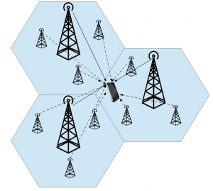
Motivation: Why CA for Comms?
Maximize Power Savings:
Current ordinary non-cognitive approach relies on manual settings for transmission power and channel data rate with limited automatic adjustment.
Manual settings tend to be a hassle for users, so adjustment is often ill-timed.
To ensure comms does not drop out in an dynamic environment, power is often set to an excessive level to cover anticipated worse case channel conditions.
Minimize Interference :
Excessive power level as a result of manual settings generates unnecessary interference.
Interference limits channel access and re-use of codes/frequencies.
Adapt to Real-time Channel Variations:
Fading and other varying channel conditions require real-time adjustment of power and rate to maintain optimal comms settings.
A Cognitive Agent approach allows for dynamic control of comms channel power and rate settings to achieve and maintain channel optimization

Slide 4
Approach
Multi-step Development of Comms Agent
Power Control Only (fixed data rate) version
Non-learning version
Reinforcement Learning (RL) version *
RL version augmented with chunking
Power and Rate Control version of Agent
Incorporation of rate adjustment
Trade off of rate and power learning to achieve channel optimization.
(Workshop results for this version of the Comms agent)
* Special thanks to Professor John E. Laird for key guidance in our efforts to migrate from a non-learning to a learning version of the agent !

Slide 5
Agent Structure
Primarily a Reinforcement Learning agent.
Uses chunking to generate RL rules
Allows for dynamic state-space
Allows for additional rules that set initial numeric preferences upon RL rule creation.
Must take care that the state-space won’t grow too large.
Has one basic operator “adjust power”.
Can adjust power by steps of -4, -2, -1, 1, 2, or 4.
Can’t adjust beyond upper or lower bounds (this constrains the state-space).

Slide 6
Agent Goals/Rewards
Goal state can change
(Dynamic Environment)
Power must adjust to optimize SNR. SNR changes depending on range/distance, weather, etc…
As opposed to the static environments in the example domains such as water jug and missionaries and cannibals that have a fixed goal (and don’t use the io-link).
Agent is rewarded each time the goal is achieved (SNR reaches desired level).
Agent is punished (negative reward) each time the link is lost.
SNR – Signal to Noise Ratio

Slide 7
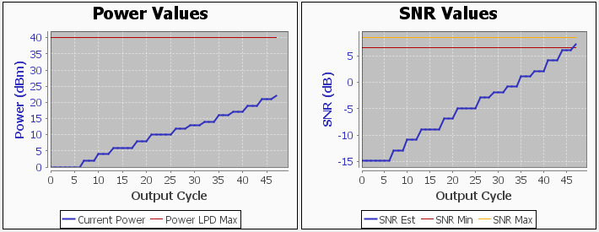
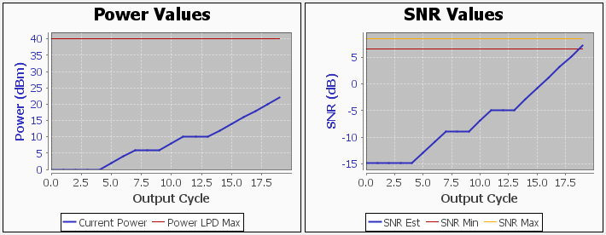
Results
Initial Run
(untrained agent)
Initial Power: 0 dBm
Final Power: 22 dBm
Range: 100 km
Soar Decision Cycles: 45
RL Rules Created: 26
Trained agent
Initial Power: 0 dBm
Final Power: 22 dBm
Range: 100 km
Soar Decision Cycles: 17
RL Rules Created: 44

Slide 8
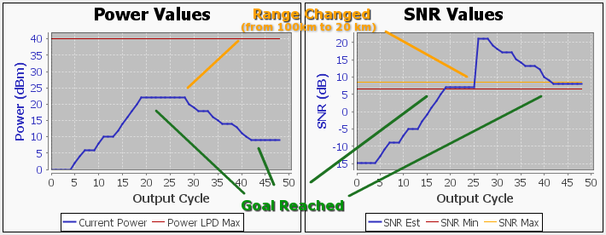
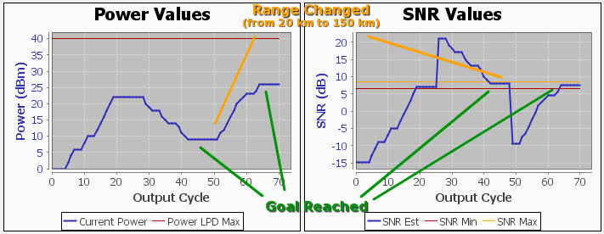
Results
Shorter range/less power
Initial Power: 22 dBm
Final Power: 9 dBm
Range: 20 km
Longer range/more power
Initial Power: 9 dBm
Final Power: 26 dBm
Range: 150 km

Slide 9
Nuggets and Coal
Nuggets
Soar agents that base decisions on IO conditions may be successfully implemented via Reinforcement Learning (RL).
Real-time IO-oriented communications Soar agents are best architected as Reinforcement Learning (RL) agents
Performance is incrementally improved over multiple runs through revision of numeric preferences
Chunking may be successfully used to augment RL through automatic generation of RL rules (state-action pairs)
Allows agent to readily adapt to changing input conditions
Expert guidance via establishing initial preferences and conditions for selection of rules accelerates the learning process
Saving and reloading of RL productions allows agent to make use of previous learning

Slide 10
Nuggets and Coal cont-
Coal
First attempts at a learning version of comms agent failed.
Determined planning and chunking structured agent is not the best approach for implementing learning in real-time IO-oriented communications
Root of issue is comms environment is dynamic with values on IO links constantly changing
IO values appear in the condition (LHS) of operator application rules, they become dependencies of the state.
When a dependency (i.e. IO value) changes, all substates generated as a result of impasses are removed, thus preventing learning.

Slide 11
Future Work
Complete Base station-Mobile Control Agent
Episodic Memory
Learning from patterns captured in episodic memory
A challenge for us… We would love to hear from any related attempts.
Localized multi-agent coordination
Modular cognitive architectures with specialized domain decision making
Multi-agent interaction and coordination
Sharing of learning and experience

Slide 12
a work in progress…
Questions ???? Comments ???
Thank you

